Slide 1
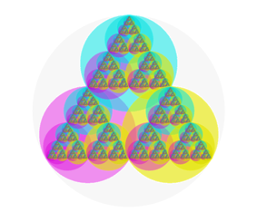


Colour Triangle
Notes:
CMY colour triangle

